Slide 1
LIBS – PEEC 2022
Pedro Jorge, Nuno Azevedo Silva

Slide 2
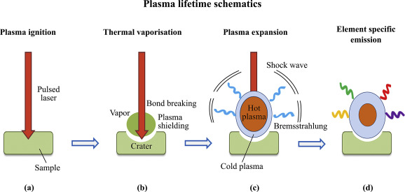
LIBS
Stands for Laser Induced Breakdown Spectroscopy
Laser induced Ablation (mJ range for ns, uJ range for ps)
followed Vaporisation
Plasma breakdown, expansion
Continuous emission (Bremsstrahlung)
(500us) Line Emission

Slide 3
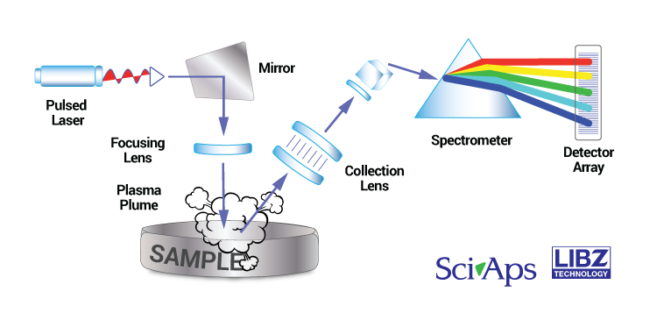
System
Laser + Focusing system (Lens, MO)
Spectrometer (Collection Lens + Grating + Detector Array
CMOS
CCD – low SNR, integration time (10 us to ms)
iCCD – few photons, smaller integration time(ns) )

Slide 4
Parameters
Laser
Pulse Energy(Q-Switch)
Wavelength (1064nm)
Pulse duration(few ns)
Repetition Rate (few Hz)

Slide 5
Parameters
Spectrometer
Wavelength range
Gate Integration time (50us to 1ms)
Gate delay (50us) - remove the continuous emission

Slide 6
Applications
Spectroscopic technique for Chemical analysis
(Competitors: ICP-MS (drawback – sample preparation, price, hours),
X-Ray (drawback – light elements, operation time(minutes) )
Advantages:
Remote
Small damage
Speed
Potential to detect All elements (Light elements vs X-Ray)
Potential to Map elements at the microscale
Price, Versatility

Slide 7
Applications
Scrap metal industry
Mining
Plastic industry
Agriculture (soils)

Slide 8
Applications
Qualitative Analysis
Semi-quantitative Analysis
Quantitative Analysis

Slide 9
Qualitive Analysis
Presence of elements
Identification of emission lines
Seek for exclusive lines
Empirical Criteria: 3/5 highest emission peaks
Sample identification and classification
Machine learning algorithms to classify samples

Slide 10
Quantitative Analysis
Quantify element mass in the sample (1-100 ppm LOD)
Regression methods F(X) = C
Linear methods F(x) = M X
(e.g. Univariate Calibration, Partial Least Squares)
Nonlinear methods
(e.g. KNN regression, Deep Learning)

